Slide 1
Assessing Plant and Lichen Biodiversity Using Reflectance Spectra
Lance Stasinski

Slide 2
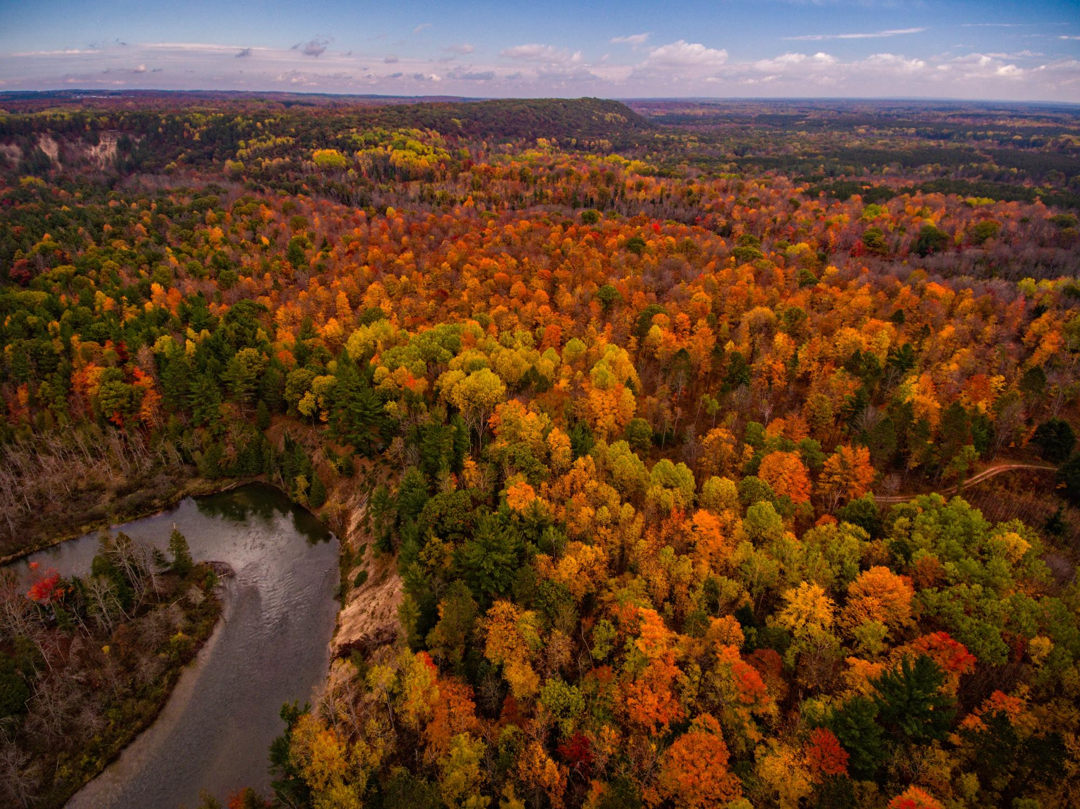

Carbon fixation
O₂
CO₂
Erosion control
Soil chemistry
Clean water
Nutrient cycling
Dennis Buchner

Slide 3
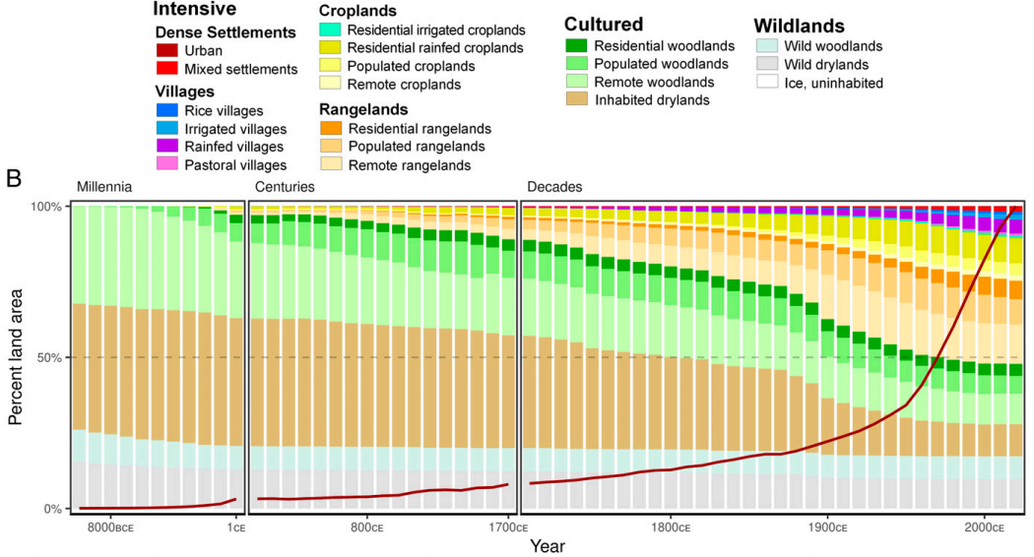
Ellis et al. (2021)
Notes:
Biodiversity is threatened from a variety of anthropogenic factors. Namely intensive land use has been increasing across time and the human population is sky rocketing. Associated consequences: habitat fragmentation, deforestation, mixing of flora and fauna (invasive species), climate change (increased greenhouse gas production). The list goes on.

Slide 4
We need to detect and monitor biodiversity in order to conserve it

Slide 5




Solution?
Reflectance Spectroscopy!

Slide 6


What is Reflectance Spectroscopy?

Slide 7
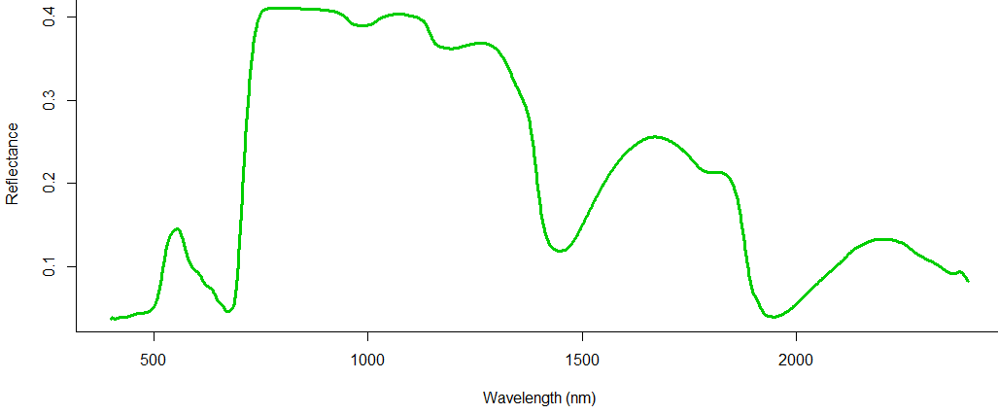
The Reflected Spectrum
Anatomy, Cellulose, Phenolic compounds
Pigments
Anatomy and Surface Features
Water

Slide 8
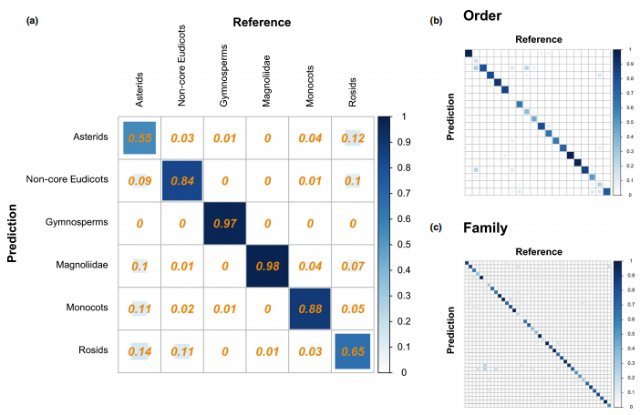
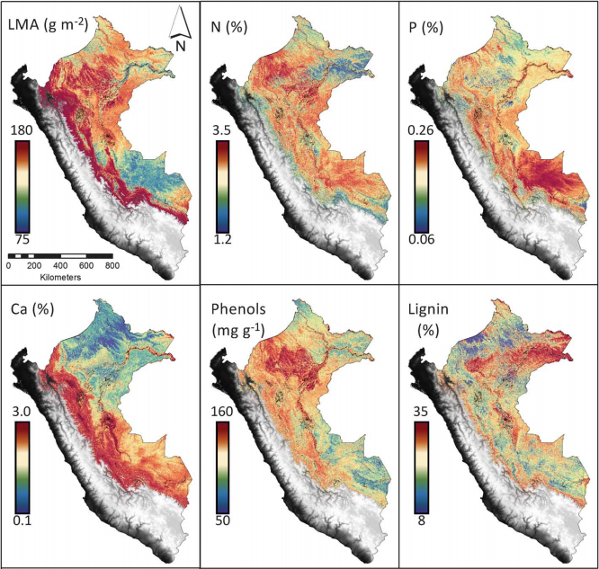
Spectroscopy is here to stay
Meireles et al. (2020)
Asner et al. (2017)
Notes:
Spectroscopy is incredibly powerful. We can distinguish taxanomic unite and estimate functional traits from light.

Slide 9


Roadblocks for spectroscopy
Not clear if we can detect fine scale taxonomic diversity
Other taxa are poorly represented in spectral libraries
Plants
Lichens

Slide 10
Outline
Detecting fine-scale diversity
Chapter 1
Expanding lichen spectral libraries using herbaria
Chapter 2
Timeline

Slide 11
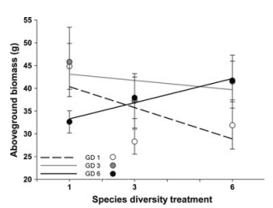
Fine-Scale Diversity – Diversity within Species and Species Complexes
Adaptive potential
Allows species/complexes to persist through change
Ecosystem processes
Productivity
Diversity at higher trophic levels
Hybridization
Adaptive potential
Transgression
a)
b)
Crawford and Rudgers (2012)
Notes:
Arthropod diversity increases with genetic diversity of plants. Transgression – hybrids more fit than parent taxa

Slide 12
Recently diverged species
Hybridization
A
A
B
Hybrid
C
B
D
Notes:
Are the phenotypes of recently diverged species different enough to be captured by spectra? Are the underlying traits of hybrids consistent enough to separate hybrids from parent species using spectra and multivariate models?

Slide 13
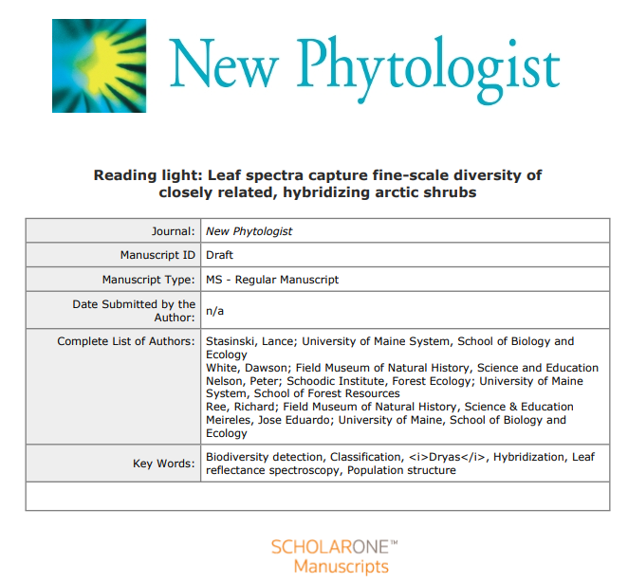
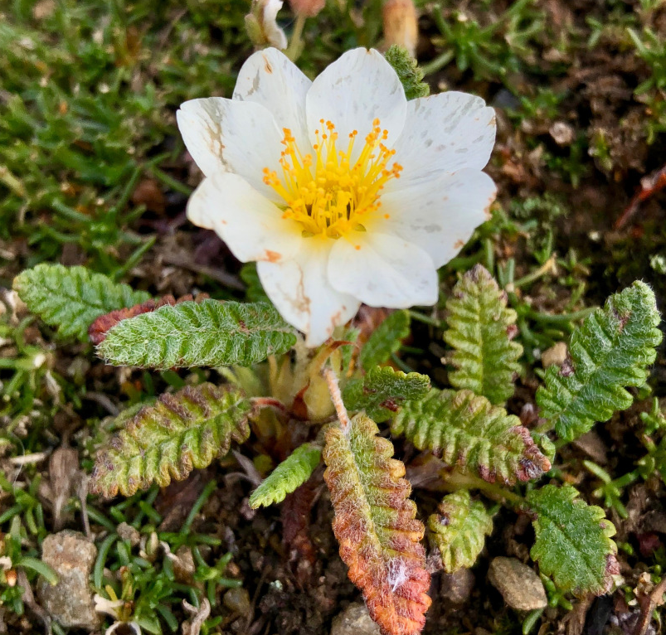
Chapter 1: Reading light: Leaf spectra capture fine-scale diversity of closely related, hybridizing arctic shrubs
D.M. White (2019)

Slide 14
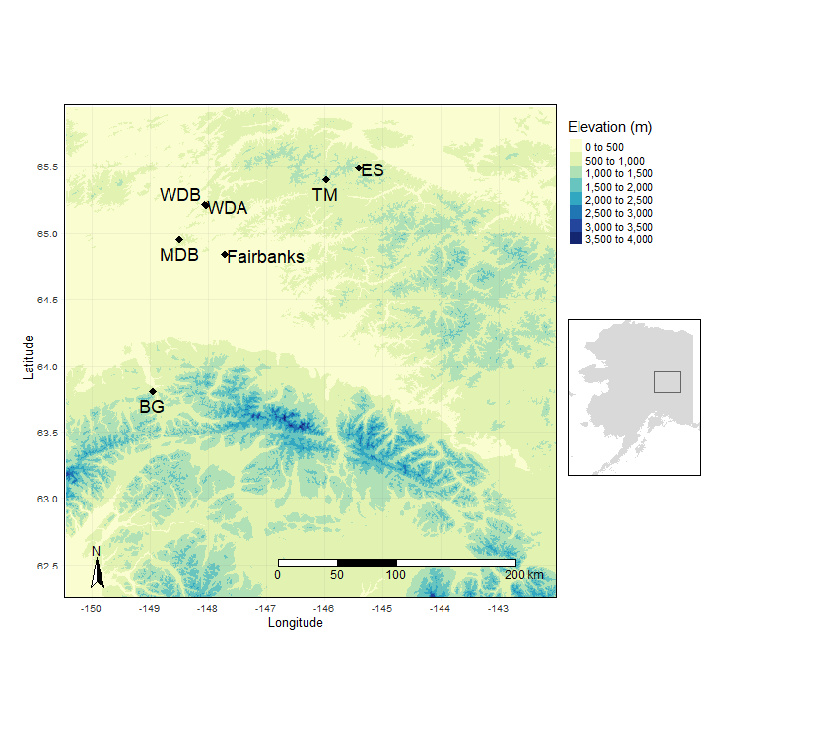
Collecting Dryas
Species
Dryas alaskensis
Alaskan endemic
Dryas ajanensis
Widespread, often confused with Dryas octopetala
Hybrids
Six sites
Data
DNA
Spectra

Slide 15
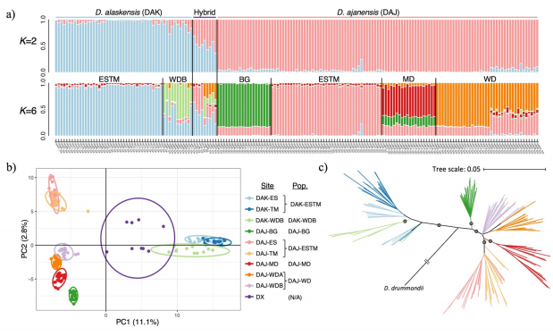
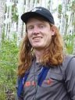
Six Populations Delimited
Genomic Data
Population delimitation
STRUCTURE
PCA

Slide 16
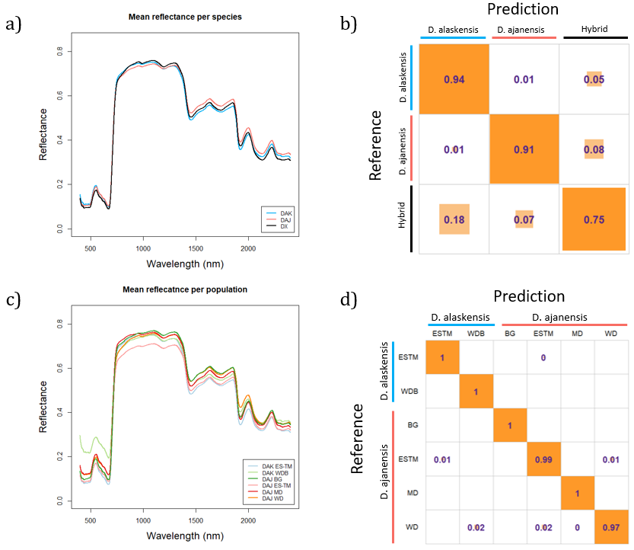
Species and Populations Predicted from Spectra
Methods
Partial Least Squares Discriminatory Analysis (PLS-DA)
Prediction Species
With hybrids: 90.8% accuracy
Without hybrids: 99.4% accuracy
Predicting Populations
99.0% accuracy
Notes:
Discuss how populations are somewhat confounded with location – however that’s the nature of this system
Discuss hybrids and how they are predicted quite well despite inconsistent traits

Slide 17
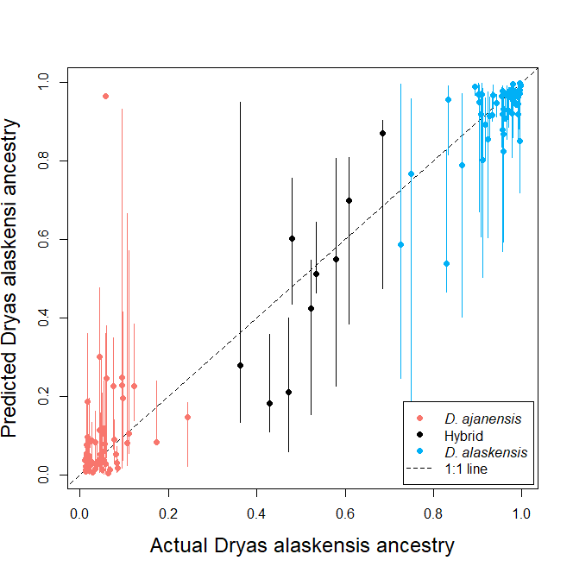
Ancestry Predicted from Spectra
Methods
PLS Beta Regression
Results
r-squared = 0.89
RMSE = 0.14
Correlation between spectral and phylogenetic distance
r = 0.26
p = 0.0001
Predicted Dryas alaskensis ancestry
Notes:
The image is just one iteration and does not necessarily reflect the average. Points represent the median prediction

Slide 18
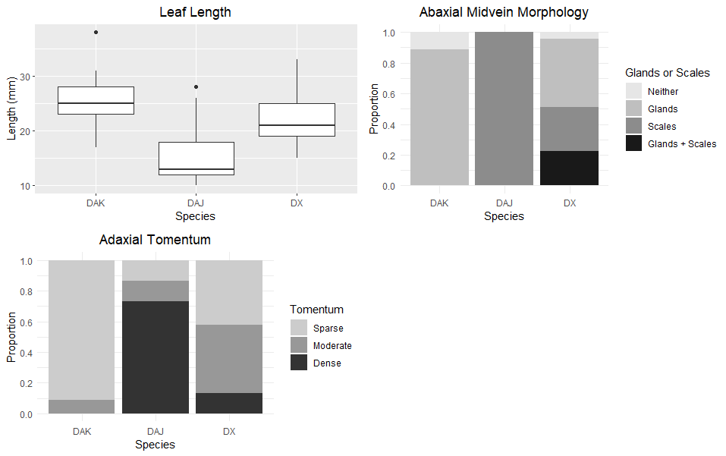
Hybrids
Did show higher trait variability than parent species
Still identified quite well (75% accuracy)
Notes:
Misclassified hybrids more closely related to D. alaskensis which further indicate genetic influence on spectra.

Slide 19
Fine-scale diversity will not necessarily be overlooked as spectroscopy becomes more prevalent as a tool for biodiversity detection and monitoring
Conclusion

Slide 20
Outline
Detecting fine-scale diversity
Chapter 1
Expanding lichen spectral libraries using herbaria
Chapter 2
Timeline

Slide 21
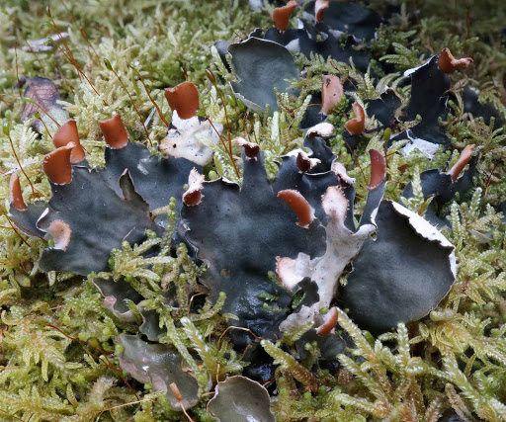
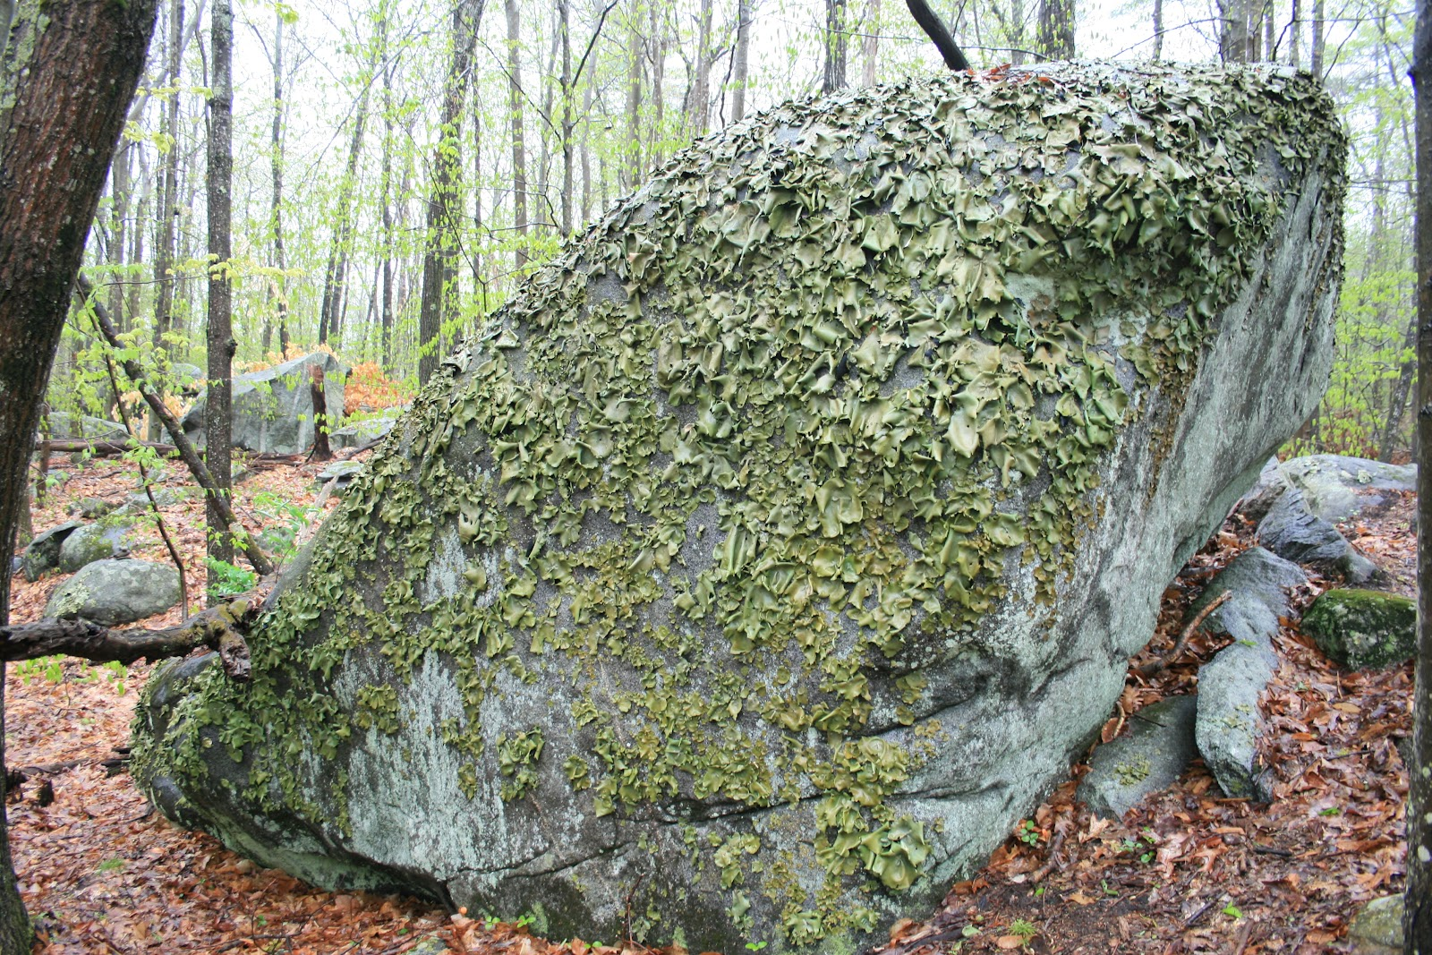
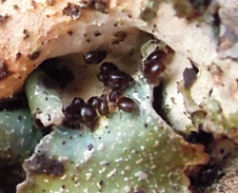
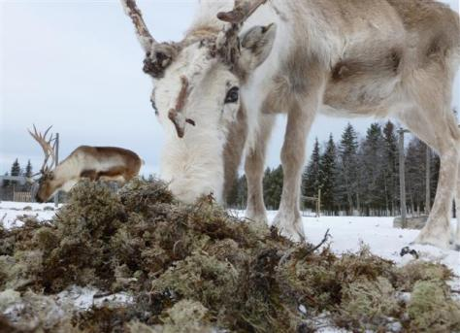
Why care about lichen?
Nitrogen fixation
Colonization
Habitat
Food source
Bioindicators
Peltigera hymenia
Rock tripe
Oribatid mites on Parmelia saxatilis
Reindeer eating lichen
Notes:
Others: nutrient cycling, evolved several times so it must be a successful way of living that deserves attention

Slide 22

Lichens
Lichens

Slide 23

Using herbarium specimens to expand spectral libraries
Can reflectance spectra of lichen herbarium specimens be used to classify species?
=
Broadly, how do spectra of lichen change with age?

Slide 24
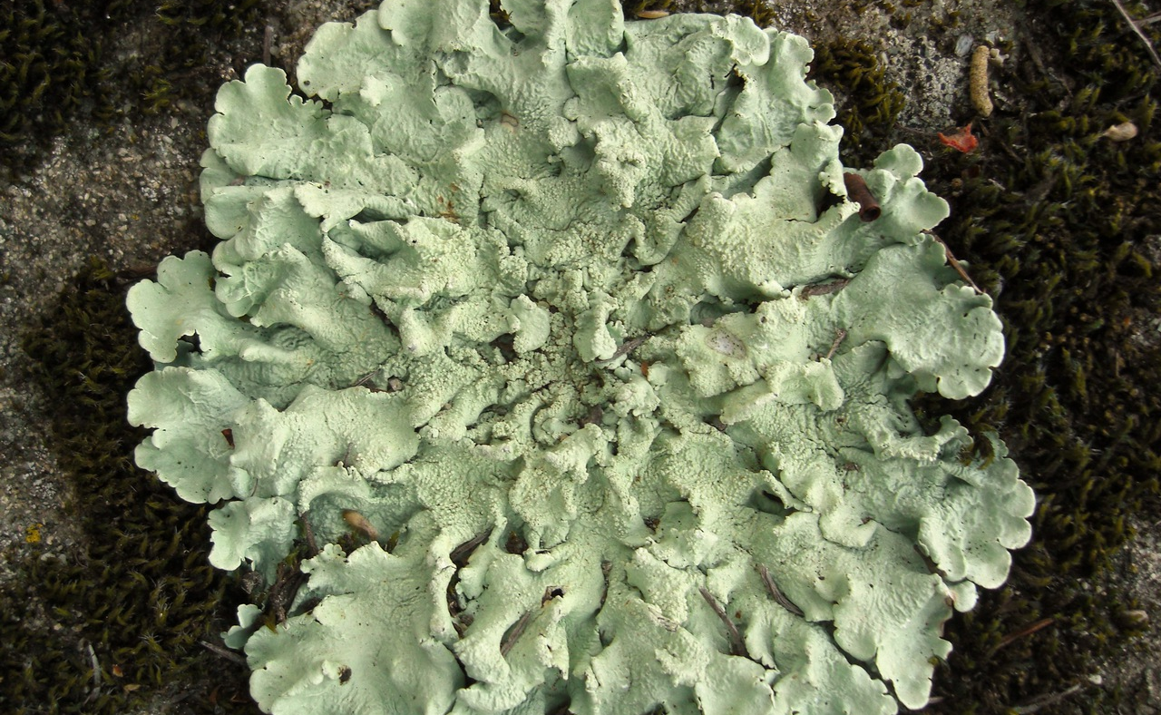
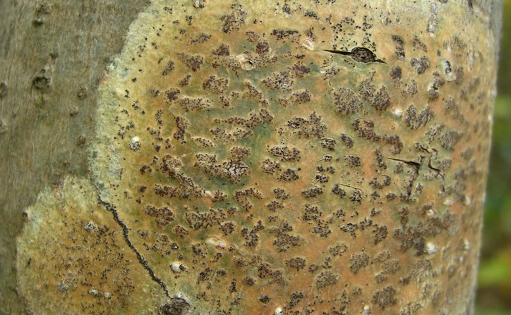
Complications
Hollinger (2011)
Diverse phylogeny: lichens evolved several times
Different desiccation tolerances
Diverse morphology and chemistry
Hollinger (2013)
Notes:
Desiccation tolerances vary based on typical habitat of the lichen species. A desert lichen handles desiccation much better than a lichen adapted for a moist forest environment. Diverse morphologies and chemistries may cause different patterns of change in the reflected spectrum.

Slide 25
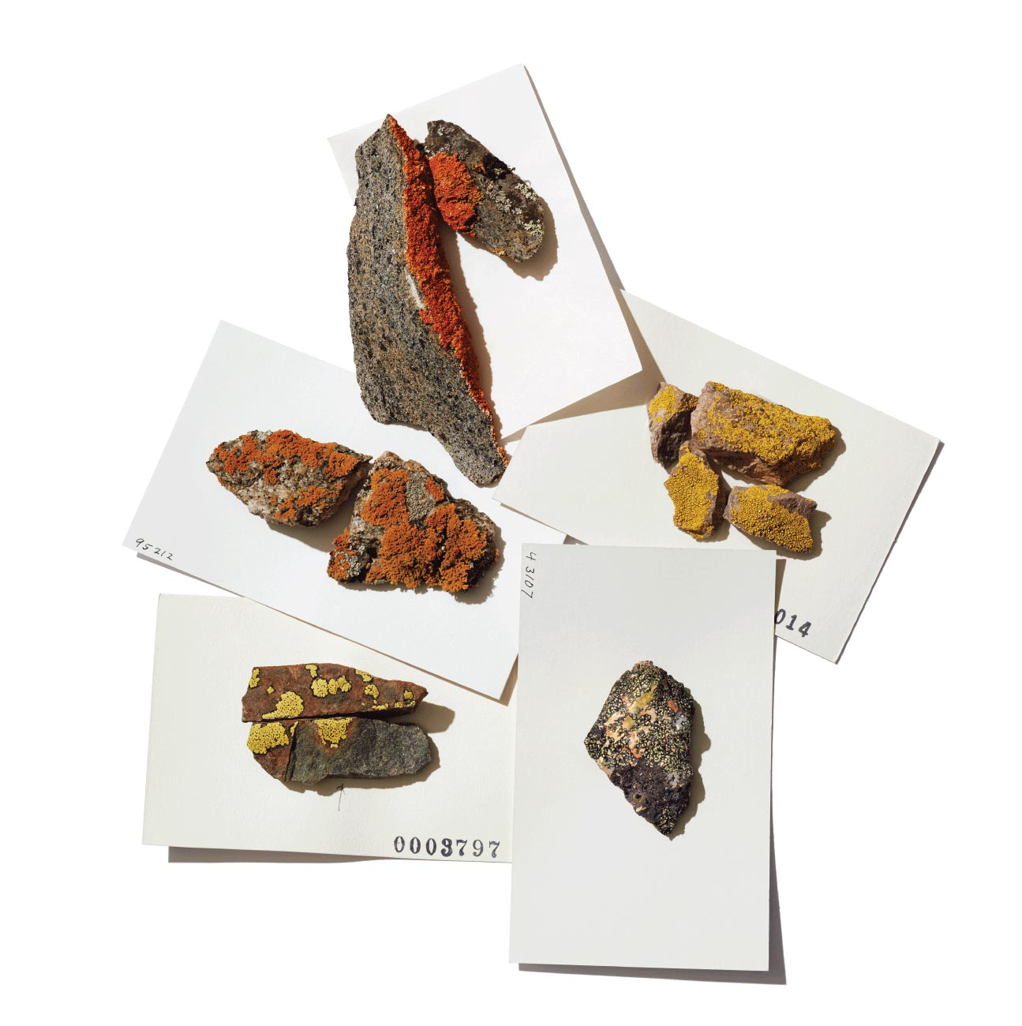
Chapter 2: Assessing Spectral Change as Lichen Specimens Age
Bell Museum

Slide 26
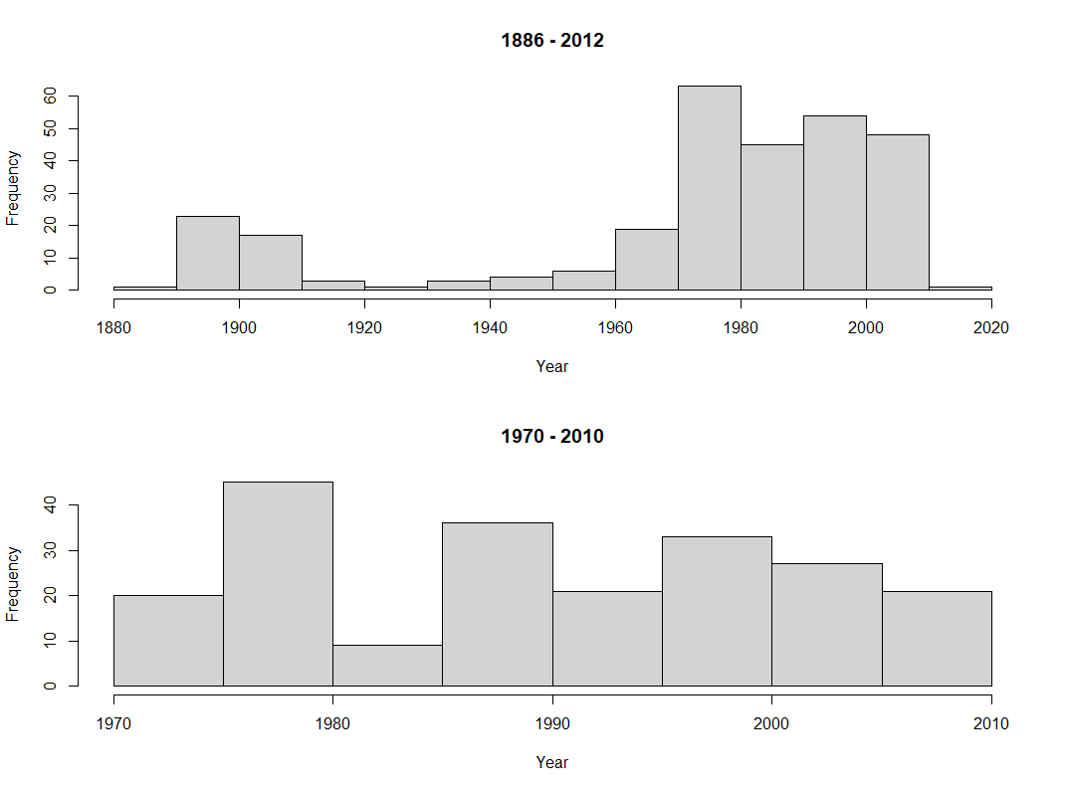

Dataset
Taxonomy
31 species
19 families
16 orders
6 classes
From the Stanton lab at UMN
Notes:
This dataset does not look at any species in particular. Rather, it is intended to make a broad statement about lichen which are often incorrectly generalized by only a handful of species

Slide 27
Can we classify species from spectra of herbarium specimens?

Slide 28
Classifying species: PLS-DA
Use only spectra as the explanatory variable
01
Use spectra and include age a covariate
02
Elucidate the importance of aging
Notes:
Compare classification accuracies

Slide 29
How do spectra change with age?

Slide 30
Functions of trait change
Adapted from Meireles et al., in prep
Underlying trait
Age
Notes:
First, we need to think about how traits could change because they inform the spectra. Translating this to the spectra, we can image that any band in the spectrum is going to respond in a similarly to the change in the underlying trait.

Slide 31
Methods
Split spectra into smaller regions
Fit functions to data
Fit constant, linear, exponential, and logistic regressions to data
Determine which fits best
Fit a cubic spline to the data then take its derivative
Reflectance at 700nm
Rate of Reflectance Change at 700nm
Age
Age

Slide 32
Goal:
Determine general patterns of spectral change for lichen.
Increase the pool of data that can be used to assess modern lichen diversity.

Slide 33
Outline
Detecting fine-scale diversity
Chapter 1
Expanding lichen spectral libraries using herbaria
Chapter 2
Timeline

Slide 34
Timeline
Summer
Start analysis
Respond to reviews for Dryas manuscript
Fall
Finish analysis
Write and submit manuscript

Slide 35



Acknowledgements
Dawson M. White
Field Museum
Dudu Meireles
University of Maine
Peter R. Nelson
Schoodic Institute
Richard H. Ree
Field Museum
Daniel Stanton
University of Minnesota

Slide 36
Questions?

Slide 37
Articles
Asner, G. P., R. E. Martin, D. E. Knapp, R. Tupayachi, C. B. Anderson, F. Sinca, N. R. Vaughn, and W. Llactayo. 2017. “Airborne Laser-Guided Imaging Spectroscopy to Map Forest Trait Diversity and Guide Conservation.” Science 355 (6323): 385–89.
Crawford, Kerri M., and Jennifer A. Rudgers. 2012. “Plant Species Diversity and Genetic Diversity within a Dominant Species Interactively Affect Plant Community Biomass.” Edited by James Cahill. The Journal of Ecology 100 (6): 1512–21.
———. 2013. “Genetic Diversity within a Dominant Plant Outweighs Plant Species Diversity in Structuring an Arthropod Community.” Ecology 94 (5): 1025–35.
Ellis, Erle C., Nicolas Gauthier, Kees Klein Goldewijk, Rebecca Bliege Bird, Nicole Boivin, Sandra Díaz, Dorian Q. Fuller, et al. 2021. “People Have Shaped Most of Terrestrial Nature for at Least 12,000 Years.” Proceedings of the National Academy of Sciences of the United States of America 118 (17). https://doi.org/10.1073/pnas.2023483118.
Meireles, José Eduardo, Jeannine Cavender-Bares, Philip A. Townsend, Susan Ustin, John A. Gamon, Anna K. Schweiger, Michael E. Schaepman, et al. 2020. “Leaf Reflectance Spectra Capture the Evolutionary History of Seed Plants.” The New Phytologist, June. https://doi.org/10.1111/nph.16771.

Slide 38
Photos
Bell Museum (n.d.) Lichen herbarium specimens [digital image]. Retrieved from https://www.bellmuseum.umn.edu/fungi/
Buchner, D. (n.d.) Mixed broadleaf forest [digital image]. Retrieved from: https://unsplash.com/photos/eDdimQeSW5c
CNX OpenStax (2016). Lichen Diagram [digital image]. Retrieved from https://commons.wikimedia.org/wiki/File:OSC_Microbio_05_05_lichenstr.jpg
Hollinger, Jason. (2011). Flavoparmelia caperata [digital image]. Retrieved from https://mushroomobserver.org/image/show_image/240112
Hollinger, Jason (2013). Trypethelium virens [digital image]. Retrieved from https://www.waysofenlichenment.net/lichens/Trypethelium%20virens
Instacart (n.d.) Green Banana [digital image]. Retrieved from https://www.instacart.com/products/16702340-green-banana-each
Oribatid mites on Parmelia saxatilis [digital image]. Retrieved from: http://www.lichens.lastdragon.org/faq/glossary2.html
Peltigera hymenia [digital image]. Retrieved from: https://lh3.googleusercontent.com/proxy/GCxzuUMgASC86sL32J05s2p1eHFhzUtYRBslhXHWpuz75LJUrOEiI7-nUSX7Yh-4yNxOYz-pAMSiiH4v1mKPwJTNkeyOW_Mtim3-WBf69vO4mYJKLO_NgTFXOUh8Q1Q
Reindeer eating lichen [digital image]. Retrieved from: https://sciencetechnologyandhealth.files.wordpress.com/2015/11/reindeer-eating-lichen-small.jpg?w=474
Rock tripe [digital image]. Retrieved from: https://easternplant.blog/2015/02/02/rock-tripe-come-see-incredible-colonies/
White, D.M. (2019). Dryas ajanensis [digital image].

